Slide 1
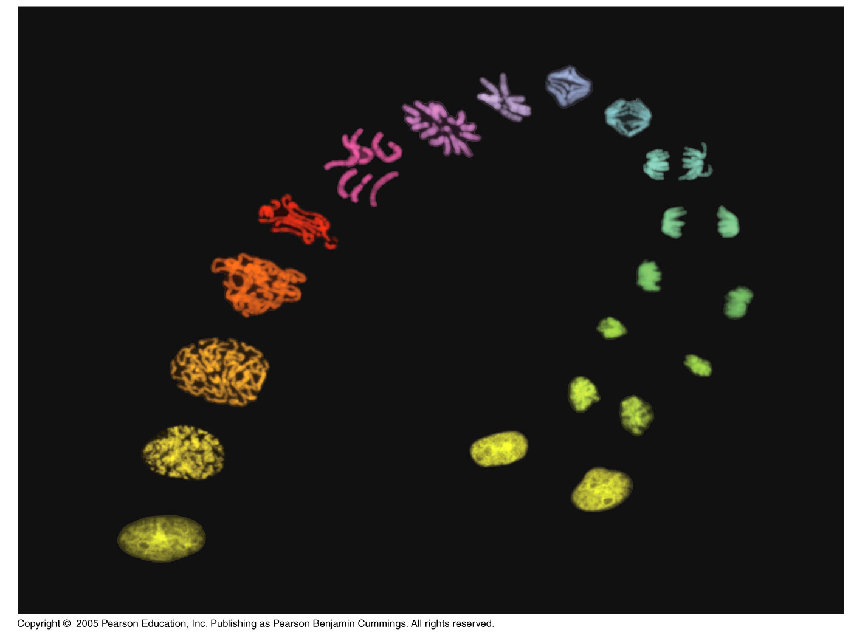
Cell Biology Lec (8)
The Cell Cycle

Slide 2
The Cell Cycle
1- The cell cycle is a series of events that leads to the replication and division of cell.
2- Two daughter cells inherit the same genetic information from the mother cell.
3- The cell cycle tightly regulated and controlled by a series of biochemical switches (checkpoints) by responding to internal and external signals.
4- In addition to replicating their genome (Genetic information), most cells replicate their other organelles and macromolecules.
5- DNA molecules in a cell are packaged into chromosomes
Prokaryotes- circular DNA
Eukaryotes- linear DNA

Slide 3
Phases of Cell Cycle
  Interphase
    First gap phase(G1)
    Synthesis phase(S)
    Second gap phase(G2)
  M phase
    Mitosis
  (C) Cytokinesis

Slide 4
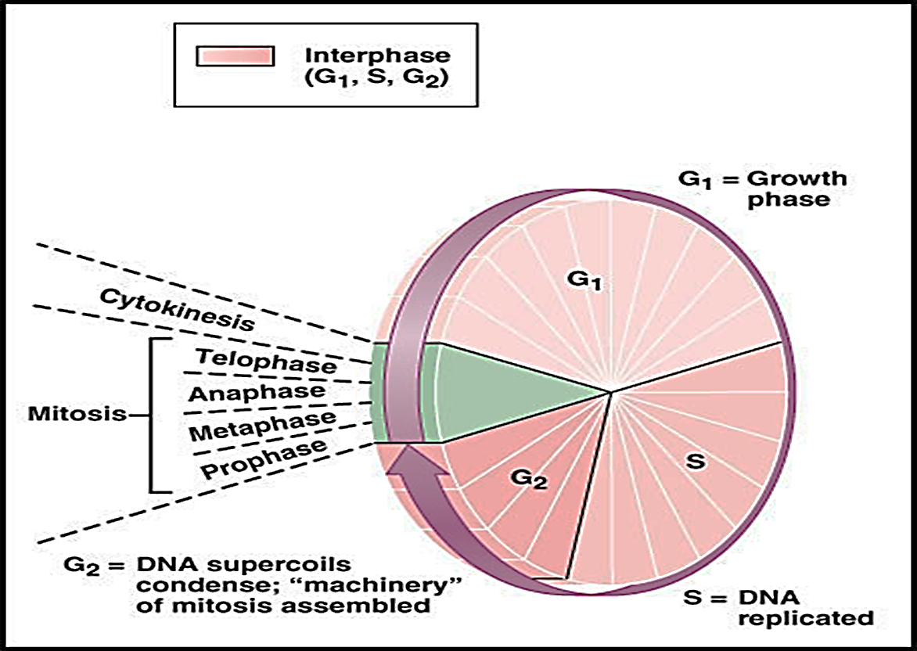
The G1 (gap) phase where the cells are grow in mass.
The S (synthesis) phase is marked by DNA replication, each chromosome now consists of two sister chromatids.
The G2 (gap) To check for unreplicated damaged DNA and To prepare for mitosis (e.g. accumulation of enzymes)

Slide 5
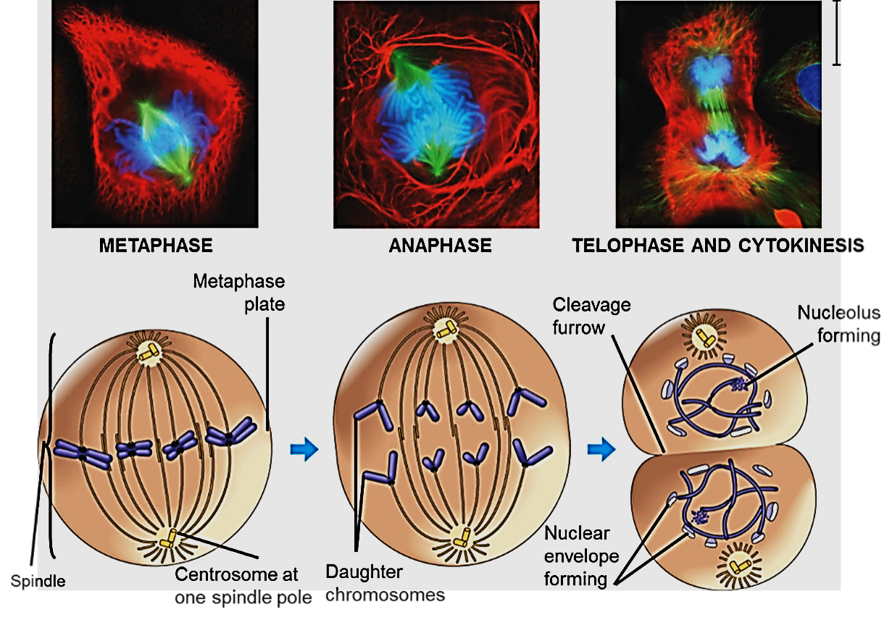
Prophase: Condensation of chromosomes; formation of two poles.
→Metaphase: Nuclear envelop breakdown; chromosomes aligned in the mid-zone.
→Anaphase: sister chromatids separated; moving to the two poles.
→Telophase: Two daughter nuclei begin to form in the cell; reformation of nuclear envelopes.

Slide 6
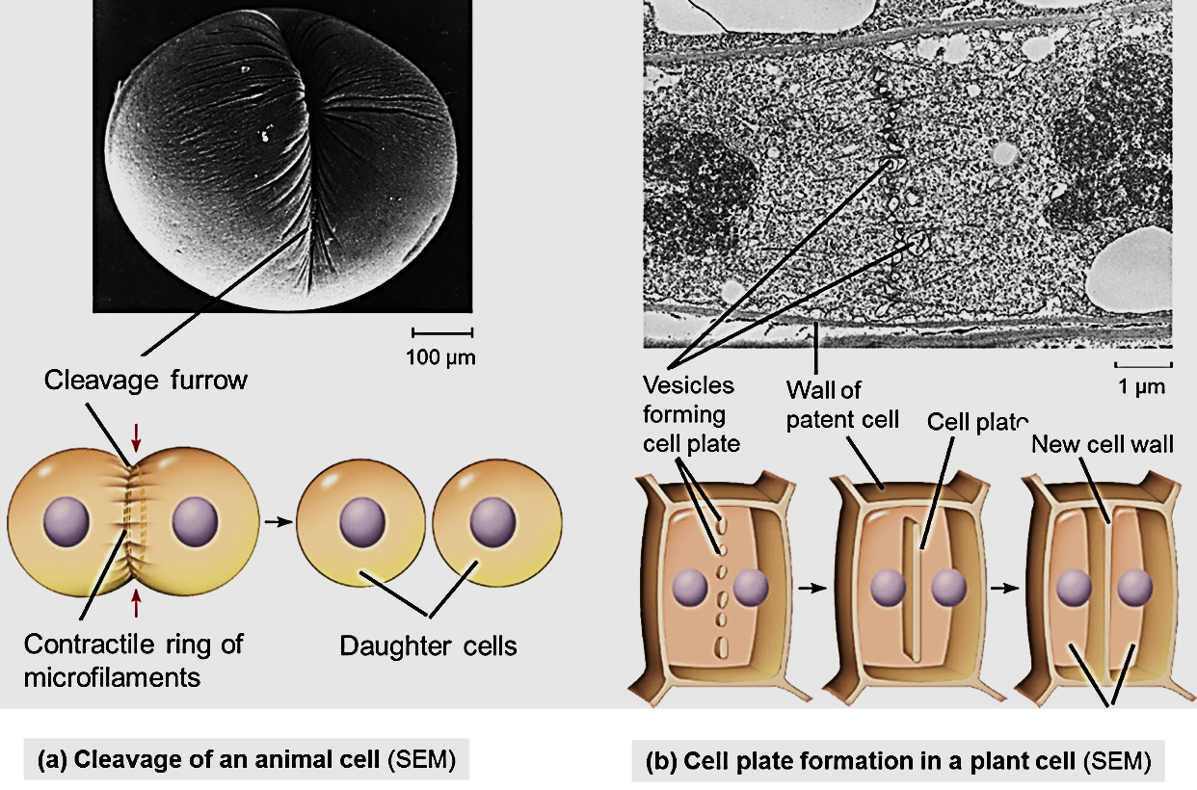
Cytokinesis
Separation of two daughter cells
**Animal cells
    Cleavage furrow
**Plant cells
    Cell plate

Slide 7
The Cell Cycle Control System
The sequential events of the cell cycle are directed by a distinct cell cycle control system, which is similar to a clock.
The clock has specific checkpoints where the cell cycle stops until a go-ahead signal is received.
For many cells, the G1 checkpoint seems to be the most important one.

Slide 8
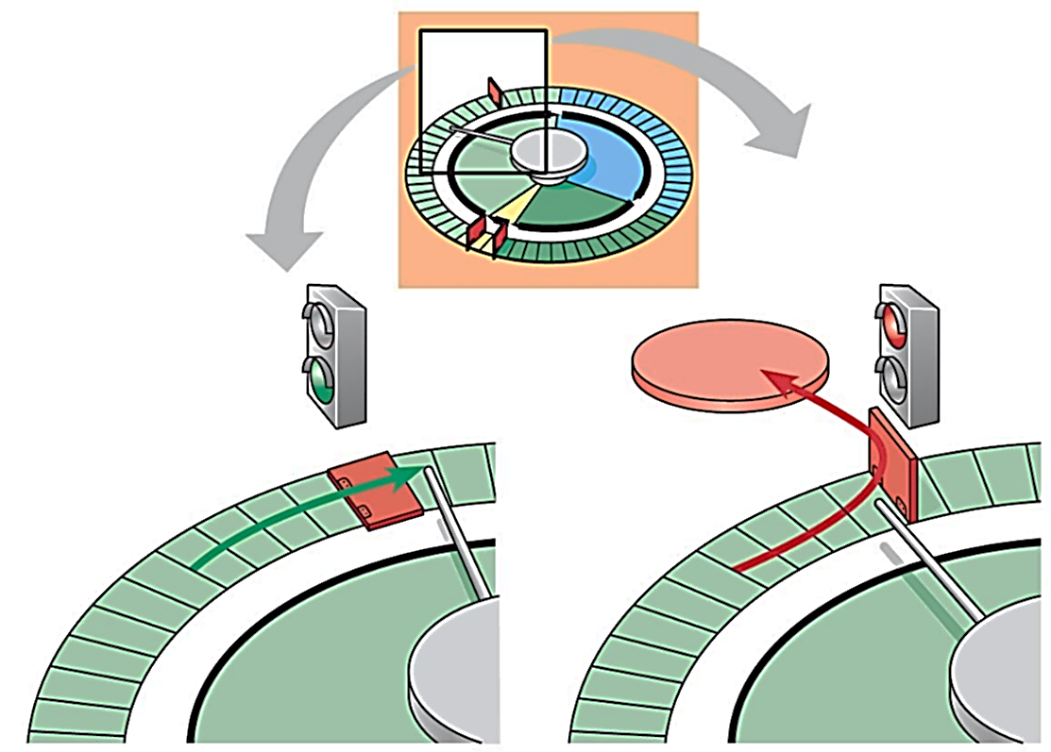
a. If cell receives a go-ahead signal at the G1 checkpoint, the cell continues in the cell cycle.
b. If a cell does not receive a go-ahead signal at the G1 checkpoint, the cell exits the cell cycle and goes into G0, a non-dividing state.

Slide 9
The Cell Cycle Control System
The chemicals that regulate the cell cycle called cyclins.
Cyclins a group of protein-regulate the timing of the cell cycle in eukaryotic cells.
There are two types of these regulatory proteins:
Internal regulatory proteins allow the cell cycle to proceed only when certain events have occurred in the cell itself.
External regulatory proteins direct cells to speed up or slow down the cell cycle.

Slide 10
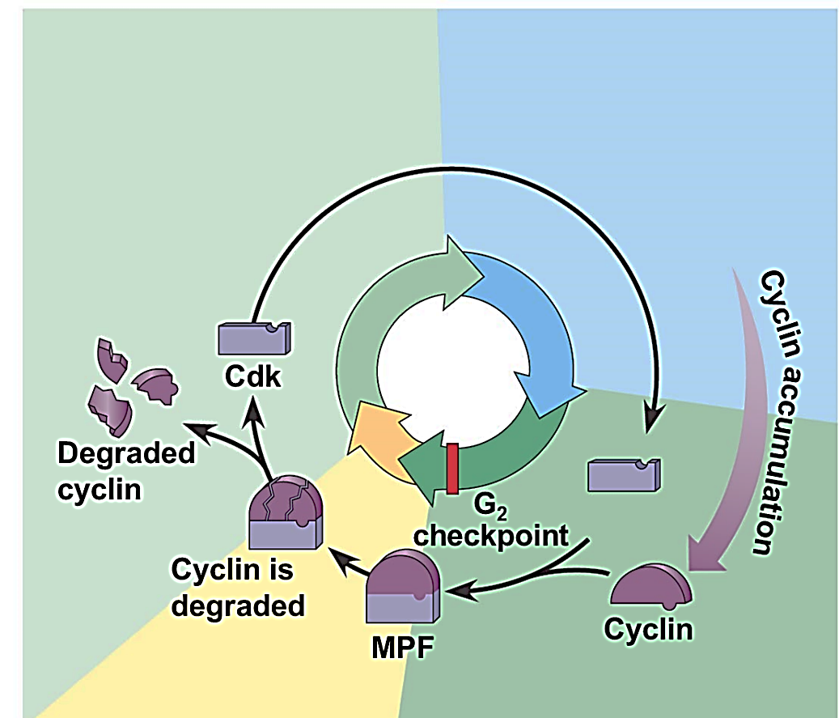

Slide 11
Cancer Cells
Cancer cells do not respond normally to the body’s control mechanisms.
Cancer cells form tumours, masses of abnormal cells within normal tissue.
Malignant tumours invade surrounding tissues and can exporting cancer cells to other parts of the body, where they may form secondary tumours.
Malignancy is due to DNA mutations resulting in increased or decreased expression of genes of cell cycle control.

